Slide 1
Lecture 6:
Themes in Indian Environmentalism - III
Course: Environment and Politics in India

Slide 2
ENVIRONMENT, IDENTITY
AND
POWER
What role do identities play in ecological debates?
What is the relationship between power and identities?
Relationship between ‘TRADITION’ and ECOLOGY

Slide 3
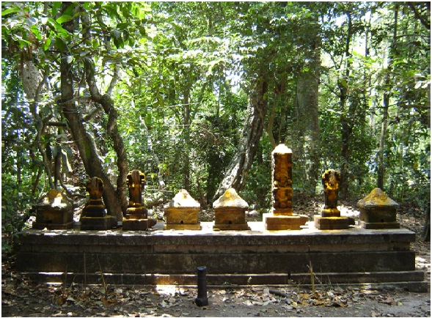

Slide 4
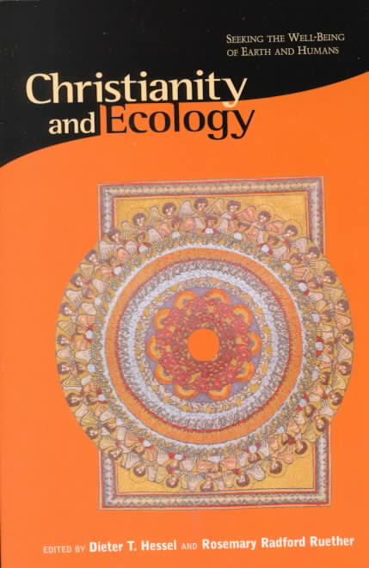
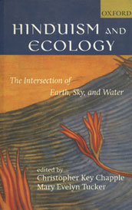

Slide 5
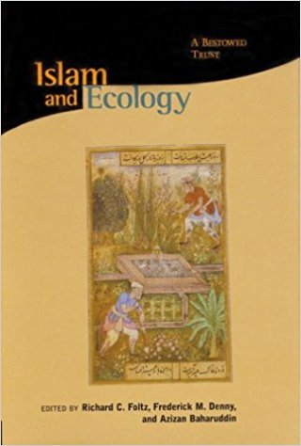


Slide 6
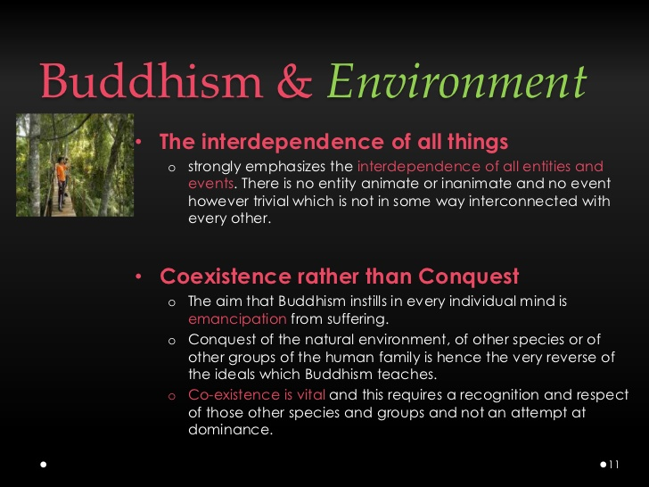

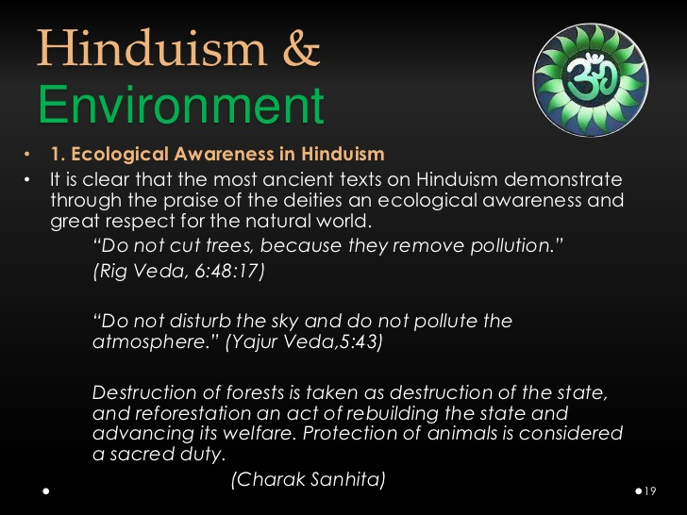

Slide 7
Identity and Environmentalism
QUESTION: Do environmental discourses (over)READ ecological rationale in ‘traditions’?
Madhav Gadgil’s ideas on Ecology and Caste:
Castes are ecological niches, they encode and transmit ecological wisdom across generations. i.e. Nature mandates the caste system.
Endogamy makes castes appear like natural species:
  Exclusive occupations/specialization
  Adaptation to ecological niches
  How does one explain:
  Occupational flexibility
  Permeability between castes
  Territorial and environmental mobility through time

Slide 8
Sacred Groves in Kerala
Kavu: Garden/forestland dedicated for the exclusive use of a deity.
Is this an example of environmental conservation?
Evidence:
  Human encroachment/disturbance, resource exploitation allowed
  Variety of rules in different kavus
  Unexploited forests, Cultivated toddy palms, Shrubbery on laterite hillocks, Tanks in the middle of paddy fields
  Sites for a variety of activities. Uses/Diety’s ‘needs’ are defined by CULTURE
  READ Rich Freeman’s Folk Models of the Forest Environment (172-173)

Slide 9
Religious attitudes towards forests
‘Religious’ attitudes towards the forest environment?
POWER struggle between humans and individual ‘beings’ in trees/plants/animals.
Protective ‘rites’ against individual trees/plants/animals.
Ambivalent attitude towards individual trees/plants/animals: Fear/reverence, hunting/worshipping.
EXAMPLE: Theyyam worship (spirit-worship, ancestor-worship, worship of Bhagwathi (Mother Goddess)/ tree/animal/serpent/Goddesses of disease/Gramadevata (Village-Deity)
Overwhelming sentiment: NOT reverence/devotion/gratitude but STRUGGLE to wrest a living

Slide 10
Social claims on ordinary forests
Do COMMONS really exist?
Often:
Commons are ‘wastelands’. Rented out by ‘owners’/managers
Hunting allowed under conditions
Swidden/agriculture allowed after cash payments/share of crop
Killing of poachers/adivasis for breaching this contract
Existence of cultural narratives of lower-caste/tribal RESISTANCE to upper-caste domination of forest/commons/’nature’ (Freeman’s Folk Models of the Forest Environment, 184-185).
Is there HEIRARCHY, COERCION and POWER in accessing ‘commons’?

Slide 11
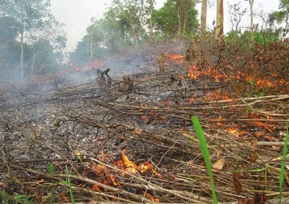
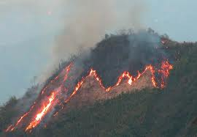
Adivasis and ‘Subsistence’ Activity
Have tribes really roamed around forests, cutting trees/hunting as they wished?
Evidence of tribes/lower castes being bound to ‘owners’. Restricted use of the forest.
Do tribes have an ‘ecologically sane’ relationship with the forest?
Evidence of axe felling, killing of trees through stripping of bark, burning (for ash/fertilizing).

Slide 12
Adivasis as ‘forest dwellers’
Have adivasis ONLY lived/depended on forests? Do they NEVER plough land?
For EXAMPLE: Have Gonds/Baigas ALWAYS lived in the forests?
Gonds/Baigas moved INTO the forests as a result of a TWO-stage process:
  Control/colonisation of fertile lands by upper-caste Hindu peasants under the patronage of the Marathas. Political/economic instability.
  British intervention, permanent settlement of zamindari lands. END of movement of adivasis BETWEEN highlands and plains.
Gonds/Baigas practiced a MIX of jhum/swidden agriculture and trade. Part of local/regional economic networks.
Gonds/Baigas were converted from being permanent cultivators being INTO hunters/gatherers.

